Slide 1
Chapter 6
What Can Computers Do for Me?

Slide 2
Three Basic Operations
Storage and retrieval
Comparison
Computation

Slide 3
Storage and Retrieval
Word processing
Databases
Tables of related data
Relationships between them
Operations on them
Standard Query Language (SQL)
No-SQL DBs

Slide 4
Storage and Retrieval
Media applications
Networking
Web
Email
Etc.

Slide 5
Computation
Fast and efficient
Accurate? Precise?

Slide 6
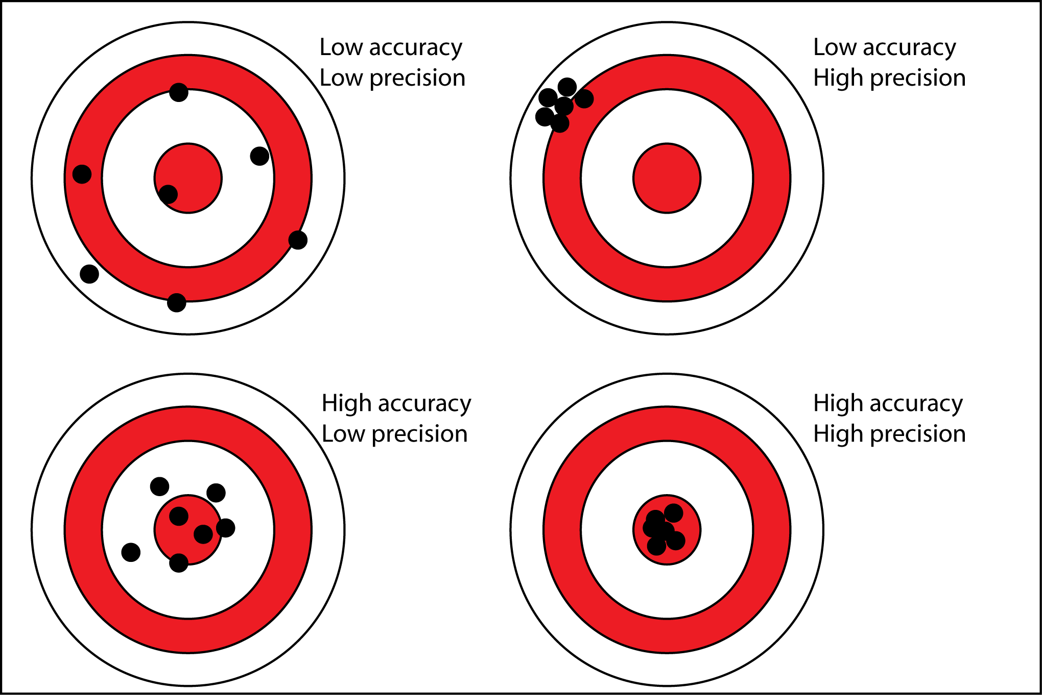
Accuracy vs. Precision
Notes:
https://sites.google.com/a/apaches.k12.in.us/mr-evans-science-website/accuracy-vs-precision

Slide 7
What Can and Can’t They Do?
Execute algorithms
Algorithms must be well defined
Have known quantities
Often physical
Variables and interactions well understood
Rocket science
Action and reaction, aerodynamics, burn rates, gravity, etc.

Slide 8
Weather Forecasting
Monitoring instruments data collection
Boring job
Ground, balloon, satellite data
Lots of data collected

Slide 9
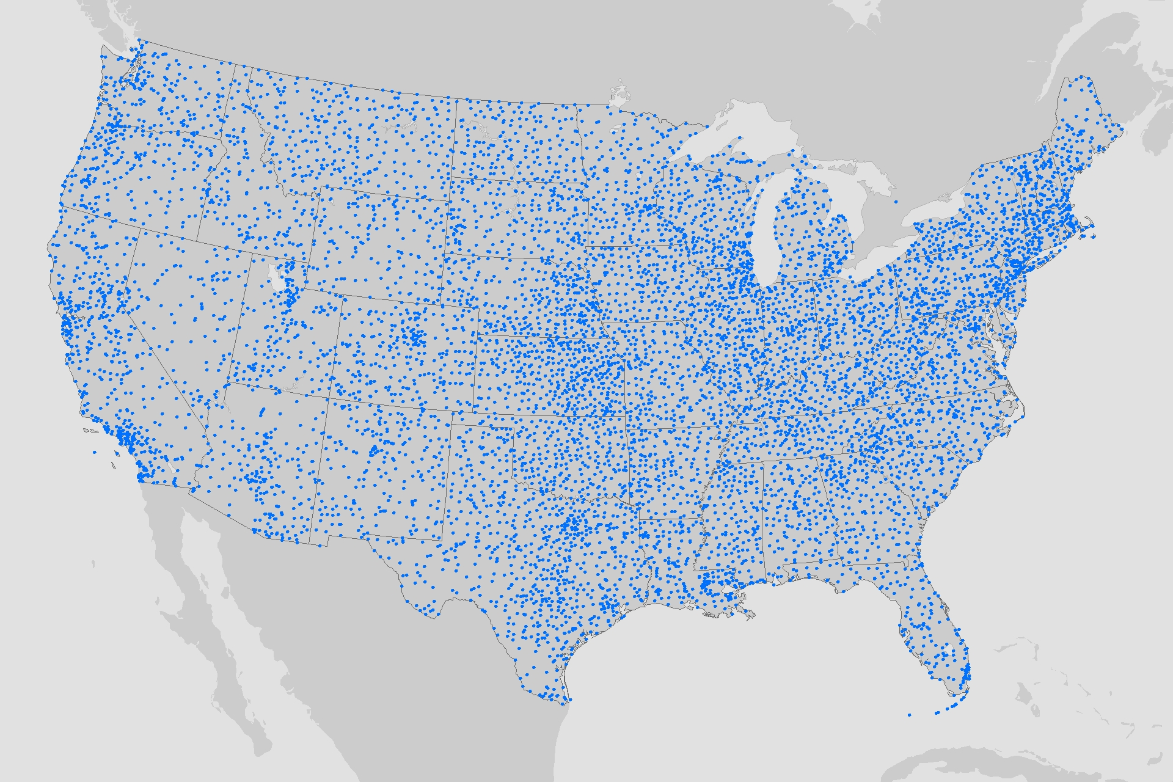
Weather Stations
Notes:
https://www.climate.gov/news-features/features/new-climate-normals-gardeners-expect-warmer-nights

Slide 10
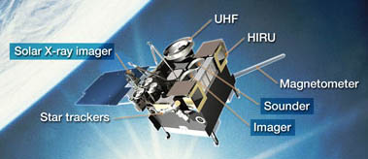
Geostationary Operational Environmental Satellite

Slide 11
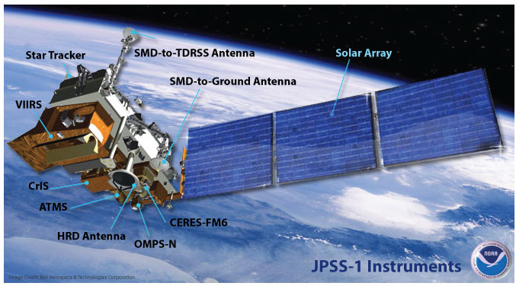
Joint Polar Satellite System

Slide 12
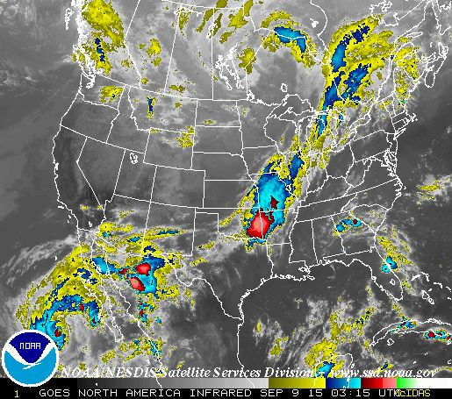
Infrared
Notes:
http://www.weather.gov/satellite

Slide 13
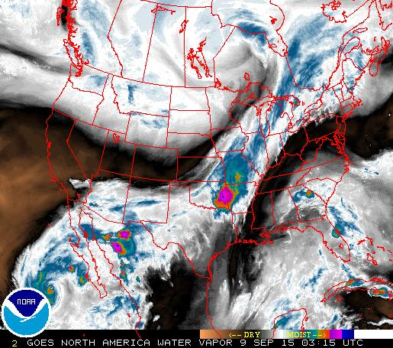
Water Vapor

Slide 14
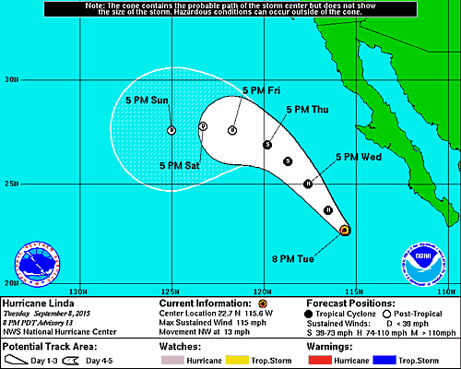
Linda

Slide 15
Model
Fluid dynamics
Heat, obstructions, ocean temperatures, etc.
The more observations, the better
Granularity
Three-dimensional grid
Lots of complex math

Slide 16
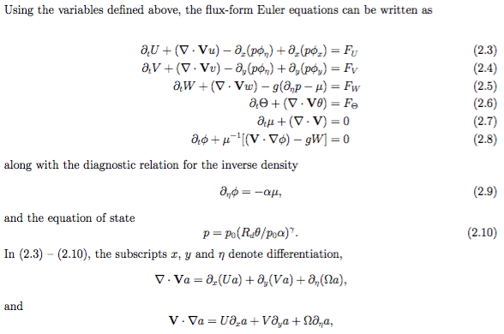
Page 18 of 100
Notes:
http://www2.mmm.ucar.edu/wrf/users/pub-doc.html

Slide 17
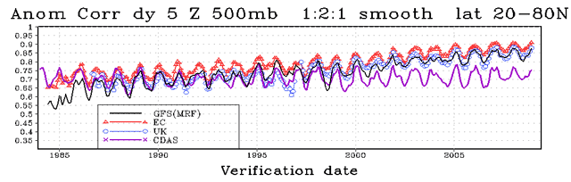
US, EU, UK

Slide 18
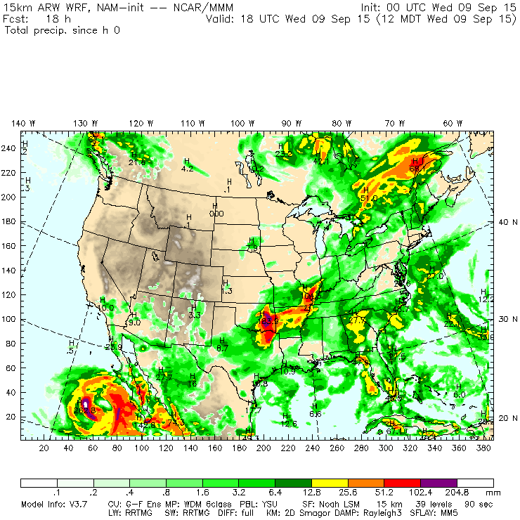
WRF Precip

Slide 19
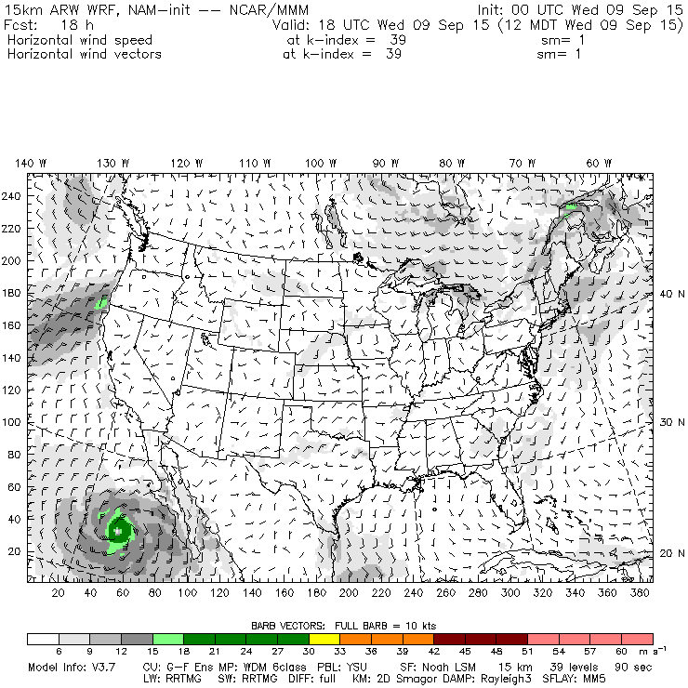
WRF Wind

Slide 20
Models
A computer representation of the actual system
Sometimes simplified
Models “run” – simulated and access for correspondence to real world
If the math is tenable, algorithms can be created

Slide 21
Chaos
Why don’t we have good predictors of the stock market?
People’s emotions involved
Many unrelated variables
Politics, economics, environment, etc.
Chaos is measure of disorder
Chaos theory
Sensitivity to initial conditions

Slide 22
Chaotic Systems
Difficult to model
Short-term models possible
Long-term models impossible
Three-body problem
“Butterfly effect”
Notes:
https://en.wikipedia.org/wiki/Chaos_theory

Slide 23
Lorenz
When the present determines the future, but the approximate present does not approximately determine the future.

Slide 24
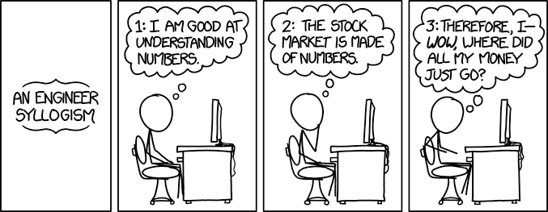
Obligatory XKCD
Notes:
http://xkcd.com/1570/

Slide 25
Personal Finance
Budgets
Taxes
Mortgages
Spreadsheets
One-table databases

Slide 26
Good Applications
Long
Tedious
Repetitive
Computers don’t get bored
Don’t make mistakes unless misprogrammed

Slide 27
Characteristics of Good Applications
Well defined
Use strengths of computers
Well tested
Errors easily addressed

Slide 28
Algorithms + Data Structures
Conditions, iteration
Data structures
How data are organized
Homogenous and heterogeneous
Arrays, structures, etc.
Problems often decomposed into smaller parts
So we can understand them

Slide 29
Decomposition
Top-down
Decomposition and refinement
Bottom-up
When we know parts of the solution
Complexity the major problem in computing

Slide 30
Computing Power
CPU, memory, I/O, storage
Can some machines do more than others?
No

Slide 31
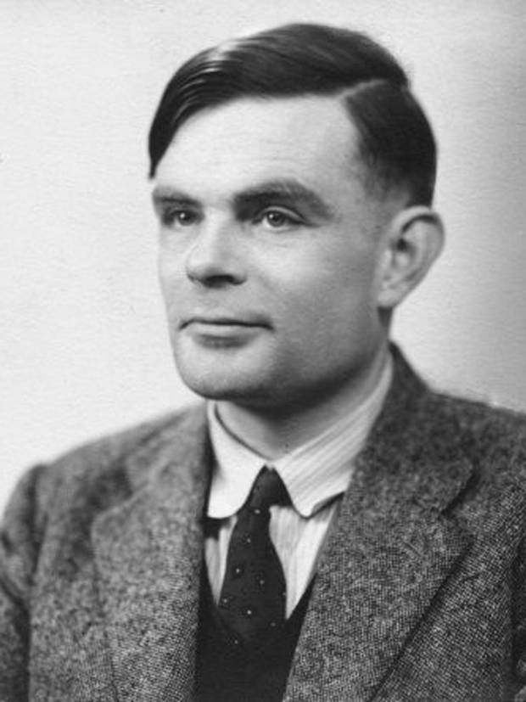
Alan Turning

Slide 32
Alan Turing
Gifted mathematician
Created much of what we know as computing
Created “universal Turing machine”
An abstract computer used to prove computational abilities
Create “Turing test”
An approach to determine if a computer has consciousness

Slide 33
Alan Turing
Major contributions to British decryption of the German Enigma machine during WWII
Blechtley Park
The Imitation Game
Benedict Cumberbatch
Keira Knightley

Slide 34
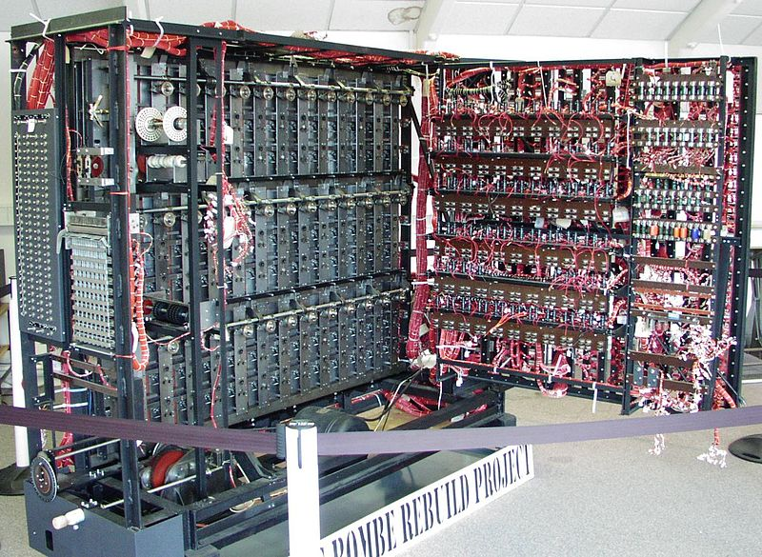

Slide 35
Alan Turing
In 1952 was convicted of homosexual acts
Died of arsenic poisoning, ruled suicide
In 2009, following an Internet campaign, British Prime Minister Gordon Brown made an official public apology on behalf of the British government for "the appalling way he was treated”
Queen Elizabeth II granted him a posthumous pardon in 2013.

Slide 36
Turing Machine
An infinite tape for I/O
Repeat
Read a character
Look up action in table
Print one character, overwriting
Move one position left or right

Slide 37
Turing Machine
Very simple but precisely defined
Basis of proofs about computing
Have all the capabilities of any computer
Though maybe not as fast, of course
Can’t solve a specific problem: the halting problem
Given a program and input, will the program stop?

Slide 38
Halting Problem
Programs can’t show that programs will stop
Can’t tell the difference between an infinite loop and not waiting long enough
Difficult to prove program correctness
See also: Heisenberg’s uncertainty principle

Slide 39
Gödel's Theorem
Theories that include a small portion of number theory
A complete and consistent finite list of axioms can never be created: each time a new statement is added as an axiom, there are other true statements that still cannot be proved, even with the new axiom
If an axiom is ever added that makes the system complete, it does so at the cost of making the system inconsistent.

Slide 40
Gödel's Theorem
Shows there will always be statements about the natural numbers that are true, but that are unprovable within the system
Shows that such a system cannot demonstrate its own consistency.

Slide 41
Liar’s Paradox
This statement is false

Slide 42
λ Calculus
Alonzo Church
Basis of LISP, Scheme, etc.
Came to same conclusions as Turing
All computers have the same capabilities

Slide 43
Universality
No task too complex that it can’t be broken down into computer instructions
As long as there is a basic set, the number of types of instructions unimportant
Computers differ in speed and interfaces, not capability

Slide 44
Review
Questions: 1, 3, 4
Exercises: 4, 5

